Slide 1

DEPARTMENT OF COMPUTER SCIENCE AND ENGINEERING
TRAFFIC MANAGEMENT
TEAM NAME: TEAM MEMBERS:
Proj_224783_Team_6 MANCHU PALLAVI(113321104055)
MANNEM HEMA SRI(113321104056)
MEESALA PRAVALLIKA(113321104057)
MEGHAA V(113321104058)

Slide 2
INNOVATION
Smart Traffic Lights: Adaptive traffic signals that adjust in real-time based on traffic conditions can reduce congestion and improve traffic flow.
AI-Powered Traffic Prediction: Advanced algorithms and machine learning can predict traffic patterns and suggest alternate routes to drivers, reducing congestion.
Connected Vehicles: Vehicles equipped with V2X (Vehicle-to-Everything) technology can communicate with each other and infrastructure, helping to prevent accidents and optimize traffic flow.
Micro-Mobility Solutions: Integration of e-scooters and e-bikes into transportation networks can reduce congestion and provide sustainable alternatives for short trips.
Automated Traffic Enforcement: Automated systems for enforcing traffic laws can free up police resources and improve safety.
Traffic App Integration: Integrating traffic data into navigation apps to provide real-time updates and suggest optimal routes to drivers.
Pedestrian and Cyclist Safety Measures: Implementing better infrastructure and technologies to protect vulnerable road users

Slide 3
PROJECT OBJECTIVES
Safety Enhancement: Implement measures to reduce accidents and improve overall road safety.
Real-time Monitoring: Develop a system that can monitor traffic conditions in real-time and provide updates to commuters.
Data Collection: Gather and analyze traffic data to make informed decisions for infrastructure improvements and traffic planning.
Environmental Impact: Reduce the environmental impact of traffic by minimizing emissions and fuel consumption.
Public Awareness: Increase public awareness and education on traffic rules and safe driving practices.
Emergency Response: Facilitate quick emergency response by providing priority routes for emergency vehicles during traffic jams.
Reduction in Commute Times: Aim to reduce the time people spend commuting to work and other destinations.

Slide 4
PROJECT REQUIREMENTS
Traffic Signaling: Adaptive traffic signal control system to optimize signal timings based on real-time traffic data.
Incident Detection: Incident detection systems to identify accidents, breakdowns, and other issues quickly.
Traffic Prediction: Traffic prediction algorithms to anticipate congestion and provide alternative routes.
Emergency Vehicle Priority: Systems to prioritize emergency vehicles, such as traffic signal preemption.
Surveillance and Enforcement: Surveillance cameras and license plate recognition for law enforcement and security.
Data Analytics: Data analytics tools for analyzing historical and real-time traffic data to make informed decisions.
Smart Traffic Lights: Implementation of smart traffic lights that adapt to traffic flow.

Slide 5
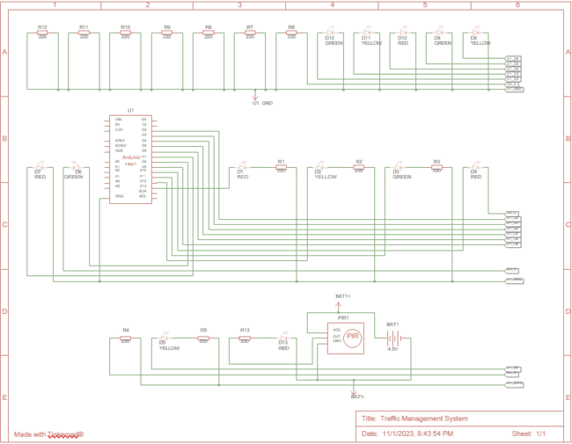
ARDUINO INTEGRATION

Slide 6
MOBILE APP DEVELOPMENT
Define your goals
Integration
Security and Privacy
Testing
User Feedback and Iteration
Quality Assurance
Deployment
Mapping and GPS Integration
Monitoring and Analytics
Cost Management

Slide 7
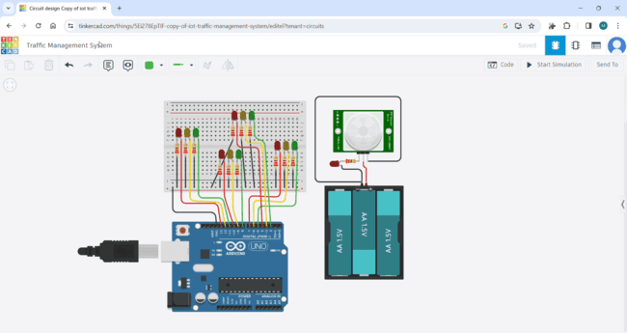
IMPLEMENTATION AND SIMULATION (Watch the simulation video below)

Slide 8
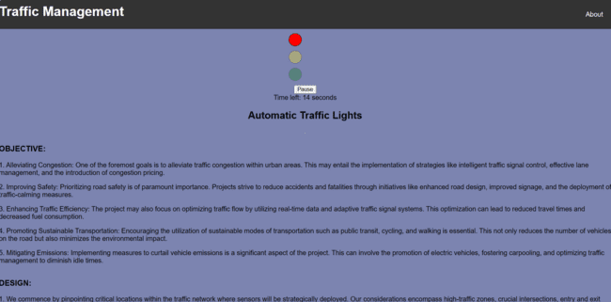
REAL-TIME WEBSITE
Click here to view code on Github Click here to check my website

Slide 9
THANK YOU

